Slide 1
Feature Extraction and Selection
Chapter 2

Slide 2
Dimensionality Reduction
Definition:
Data transformation from a high-dimensional space into a low-dimensional space so that the new representation still retains some meaningful properties of the original data.
Feature Selection is a process that chooses an optimal subset of features according to a certain criterion.

Slide 3
Dimensionality Reduction
Why do we need Dimensionality Reduction?
Improve performance (regarding speed, predictive power, and model complexity).
Visualize the data for model selection.
Avoid the curse of dimensionality and remove noise.

Slide 4
Dimensionality Reduction
Feature Selection
seeks a subset of the original features that retains most of the relevant information.
Filters
Wrappers
Embedded methods
Feature Extraction
combines/fuses the n original features into a smaller set of newly created features which hopefully retains most of the relevant information from all the original features.
PCA/SVD
T-SNE
Neural Network – VGG16

Slide 5
Feature Selection
Advantages:
removing irrelevant data.
increasing predictive accuracy of learned models.
reducing the cost of the data.
improving learning efficiency, such as reducing storage requirements and computational cost.
reducing the complexity of the resulting model description,
improving the understanding of the data and the model.

Slide 6
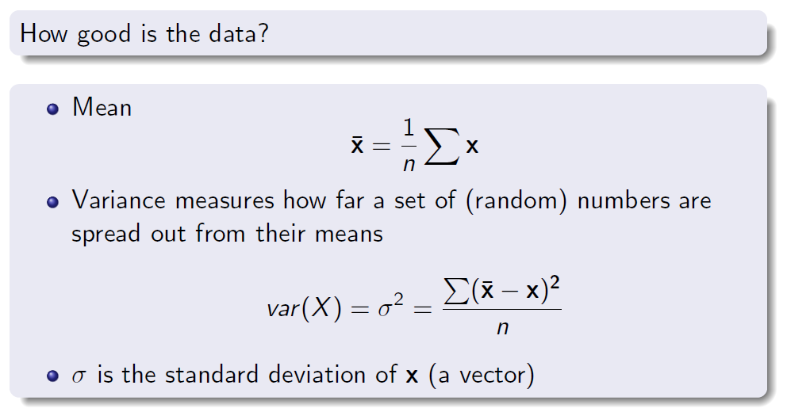
Feature Analysis

Slide 7
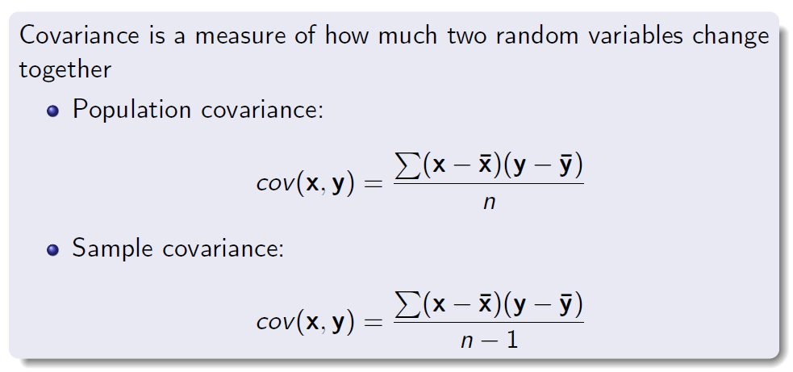
Feature Analysis

Slide 8
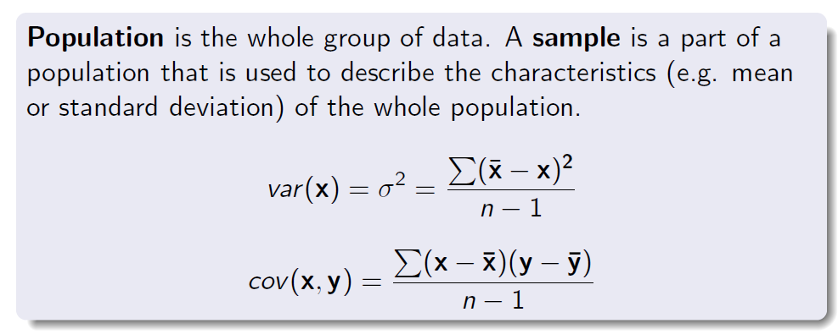
Feature Analysis

Slide 9
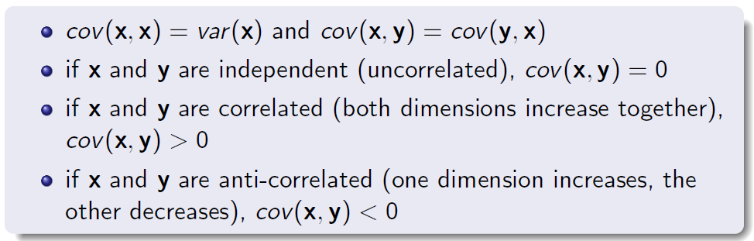
Feature Analysis

Slide 10
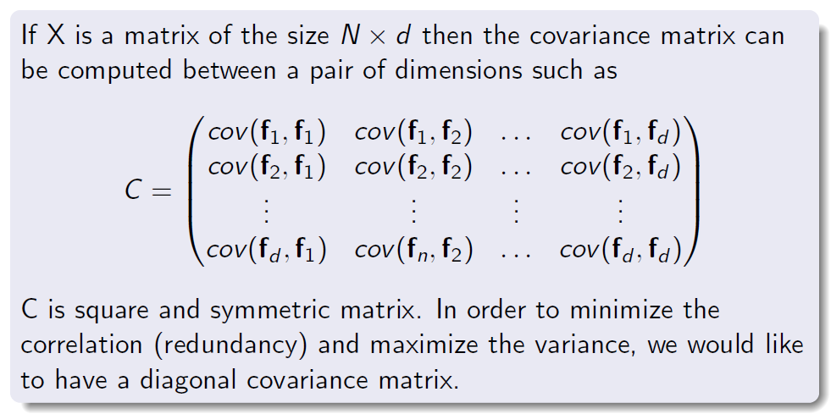
Feature Analysis

Slide 11
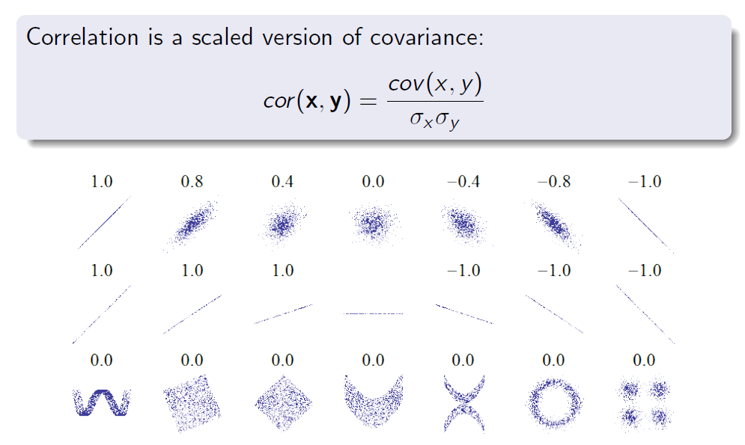
Feature Analysis

Slide 12
Feature Analysis
A pair of correlated features provides a high correlation score
These features may be useful for training models.
Uncorrelated features have no relationship between them.
Correlation, known as, Pearson correlation coefficient.

Slide 13
Feature Selection
Given d, the number of original features:
How do you select the best feature subset (the number of selected features p < d)?
What are the criteria to evaluate each feature subset?
What are the principles for adding, removing, or changing features in the subset during the selection process?

Slide 14
Feature Selection
Filter methods
Find a score to rank the relevance of each feature (or feature subset).
Features with the best scores are selected.
Wrappers
Optimizes for a specific learning algorithm.
The feature subset selection algorithm is a "wrapper" around the learning algorithm.
Embedded
Determine and extract the importance of features during the training process.
Algorithms: Random Forest, L1 Regularization.

Slide 15
Feature Selection
Filter methods
Filters can work independent of any particular learning algorithm.
Variance
Laplacian Score / Constraint Laplacian Score
Hierarchical Laplacian Score

Slide 16
Feature Selection: Filters
A feature with a variance close to zero is approximately constant and will not improve the performance of the model.
If the variance is large, the data is spread through distribution.
→ Keep features/attributes with large variance (the threshold depends on data distribution)

Slide 17
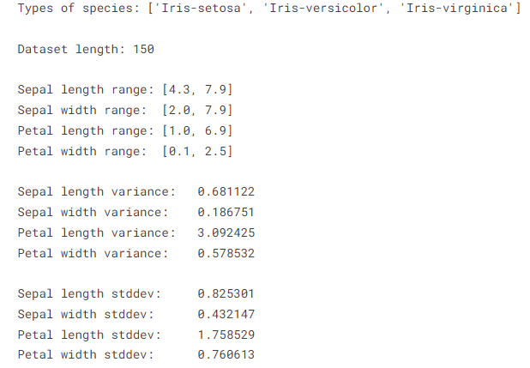
Feature Selection: Filters
Variance of the Iris dataset

Slide 18
Feature Selection: Filters
Lab-work:
Try different simple models (clustering or classification) with the use of the only feature with the maximum variance.
Calculate the performance and make a comparison when you use only one feature vs all features.

Slide 19
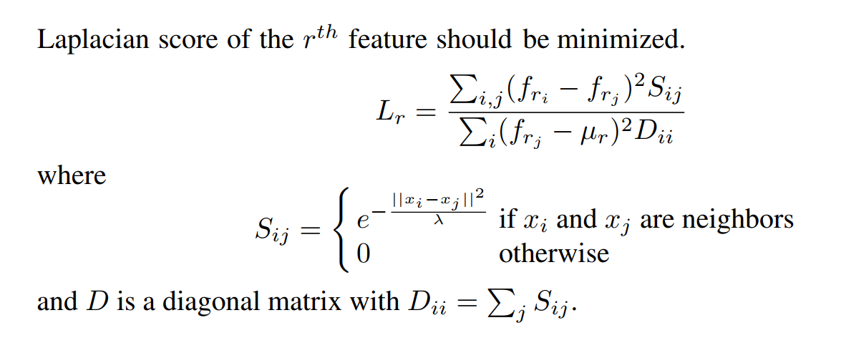
Feature Selection: Filters
Unsupervised feature selection

Slide 20
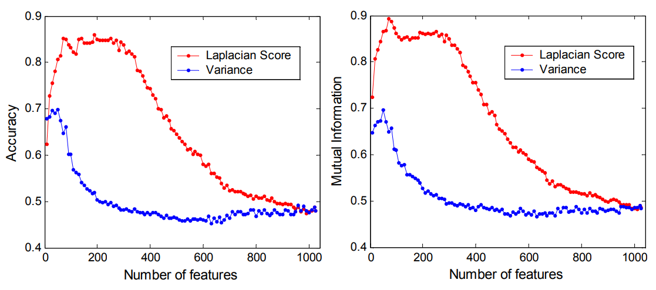
Feature Selection: Filters
K-means on CMU Multi-PIE Face Database: K=5

Slide 21
Feature Selection: Wrappers
Supervised feature selection
(Probably) Include labels in defining the ranking score for each feature.
Define a cost function (probably certain quality measures)
Optimize the cost function for each feature subset.
Work well for only one specific scenario per dataset.
We need to perform different studies for different datasets.

Slide 22
Feature Selection: Wrappers
Pick a feature subset and pass it in to the learning algorithm
Create a training/test set based on the feature subset
Train the learning algorithm with the training set
Optimize accuracy (objective) with the validation set
Repeat for all feature subsets and pick the feature subset that led to the highest predictive accuracy (or other objective)

Slide 23
Feature Selection: Wrappers
Exhaustive Search: Forward Search
Score each feature by itself and add the best feature to the initially empty set FS
Try the subset consisting of the current FS plus one remaining feature and add the best feature to FS
Continue until stop getting significant improvement

Slide 24
Feature Selection: Wrappers
Exhaustive Search: Backward Search
Score the initial complete FS
Try each subset consisting of the current FS minus one feature in FS and drop the feature from FS causing least decrease in accuracy
Continue until begin to get significant decreases in accuracy

Slide 25
Feature Selection: Embedded
Embedded methods:
Take benefits from both the wrapper and filter methods by including feature interactions while maintaining reasonable computational costs.
Embedded methods iterate each iteration of the model training process and carefully extract those features that contribute the most to the training for a particular iteration.

Slide 26
Feature Selection: Embedded
L1-Regularization or Lasso Regression (Least Absolute Shrinkage and Selection Operator) adds “absolute value of magnitude” as a penalty to the loss function.
Remove features that do not serve any purpose in the model by penalizing their weight to be approximately zero.

Slide 27

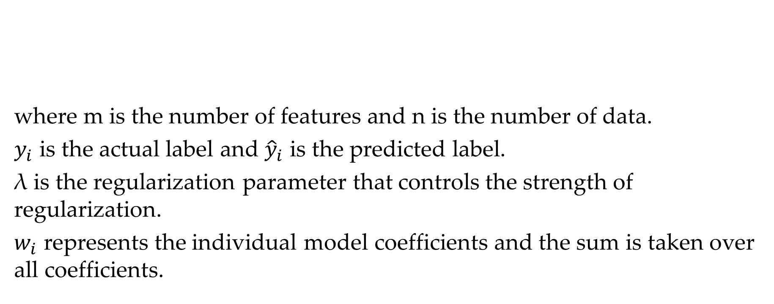
Feature Selection: Embedded
where m is the number of features and n is the number of data.
$y_{i}$ is the actual label and ${\hat{y}}_{i}$ is the predicted label.
λ is the regularization parameter that controls the strength of regularization.
$w_{i}$ represents the individual model coefficients and the sum is taken over all coefficients.

Slide 28
Feature Selection: Embedded
Random Forest
A supervised model relies on the decision tree and bagging methods.
Training dataset is resampled according to a procedure called “bootstrap”.
Each sample contains a random subset of the original columns and is used to fit a decision tree.
The number of models and the number of columns are hyperparameters to be optimized.
The predictions of the trees are obtained by the vote of majority.

Slide 29
Feature Selection: Embedded
Random Forest
Each tree of the random forest can calculate the importance of a feature according to its ability to increase the pureness of the leaves.
The higher the increment in leaves purity, the higher the importance of the feature.
The pureness at the leaves:
Information gain
Gini index

Slide 30
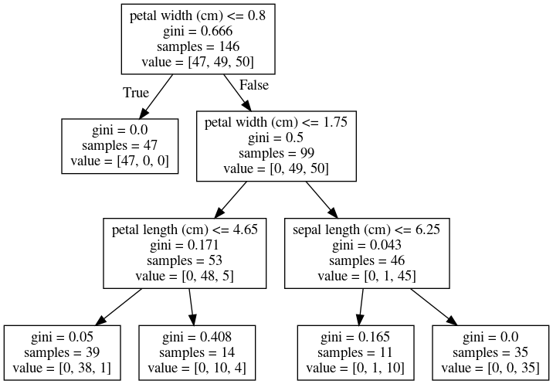
Feature Selection: Embedded
Random Forest:
Decision Tree

Slide 31

Feature Selection
Filter methods
Low complexity
Low performance
Apply for generative datasets
Wrappers
High complexity (often O($n^{2}$))
Better performance
Work only for a specific dataset

